Slide 1
Webscraping GoodRx
Pricing of Rx ED Medications
Adriana Bartlett Gray
NYC Data Science Academy

Slide 2
The Landscape
Impact
Insurance
For every decade of a man’s life, his chances of experiencing some level of ED increases by 10%.
Most health insurance plans exclude ED Medications from coverage. Paying out of pocket is often the only option.
Embarrassment
Ethics
Transparency
Embarrassment makes it less likely that a person will discuss or compare prices.
This creates an environment where predatory practices abound… especially on the internet.
Who can you trust? How do you know you are getting a good/fair deal? How do you avoid being scammed?

Slide 3
Self-Pay Options
Male Medical Center
(NuMale Medical Center, American Male Medical, Summit Male Medical, etc.)
Online Bundled
(GetRoman, ForHims, etc.)
Telehealth + Rx Discount Card
(HeyDoctor, ZocDoc, Dr On Demand, etc.
+ GoodRx, SingleCare, RxSaver, etc.)
Pros:
More thorough in-person evaluation & screening
More alternatives for treatment
Cons:
High cost for consultation
High cost for meds
12x higher (anecdotal)
Non-transferrable Rx
Possible conflict of interest
Pros:
Initial appointment is often free of charge
No in-person appointment (avoids embarrassment if this is a concern)
Cons:
High cost for meds
10 – 40x higher (company website)
Subscription model
Non-transferrable Rx
Possible conflict of interest
Pros:
Appointment is low-cost or may be covered by insurance
No in-person appointment (avoids embarrassment if this is a concern)
Rx can be called into any pharmacy of the patient’s choosing and is transferrable
Rx discount card is free (or coupon can be printed for free)
No conflict of interest
Cons:
Initial telehealth appointment without insurance is not free (approximately $40-$60)

Slide 4

What’s the Catch?
You’re not done shopping around yet..
Prices still vary A LOT within a Rx Discount Card program.
You could still be paying 10x+ the price of the lowest cost pharmacy provider if you don’t compare prices on the program’s app or website.
However, this quick delve into the data may point you in the right direction even if you don’t want to take the time to check online.
And, show you a way to save another 50%

Slide 5
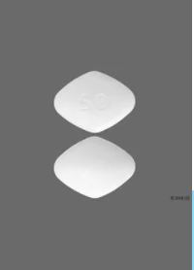
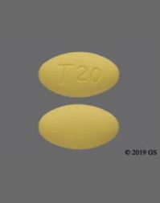
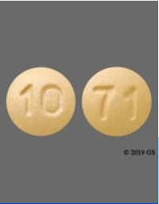
Data Scraped from GoodRx
By Zip Codes:
Sildenafil
Tadalafil
Vardenafil
10025 – New York 60629 -- Chicago
77084 – Houston 90011 – Los Angeles
Retrieving:
Pharmacy Name
Pharmacy List Price
Pharmacy GoodRx Discount Price
Generic Viagra/Revatio
20 | 25 | 50mg* | 100
(30 pills)
Generic Cialis
2.5 | 5 | 10 | 20mg*
(30 pills)
Generic Levitra/Staxyn
2.5 | 5 | 10 | 20mg*
(30 pills)

Slide 6
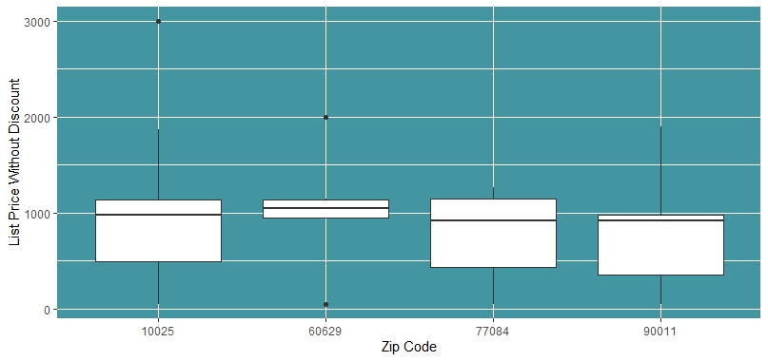
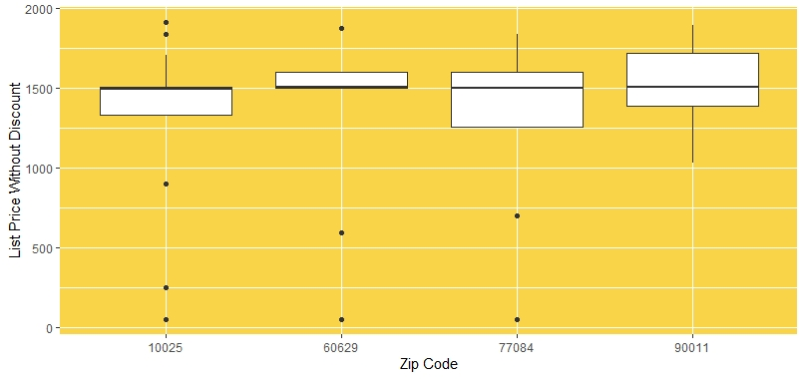
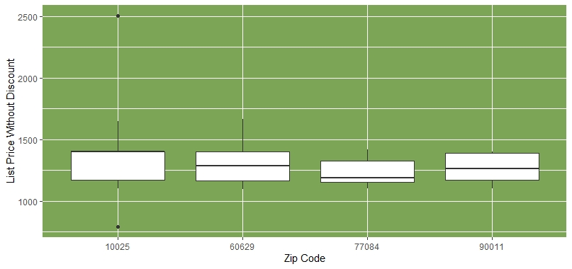
List Price Sticker Shock
Sildenafil | 50mg | 30 count
Tadalafil | 20mg | 30 count
Vardenafil | 20mg | 30 count
Key Observations:
Median list price is roughly between $1000 and $1500 per bottle across all medications (based on typical dose and 30 count of pills).
Median list price is relatively consistent across zip codes for each medication.
Variability in list price is very high.

Slide 7
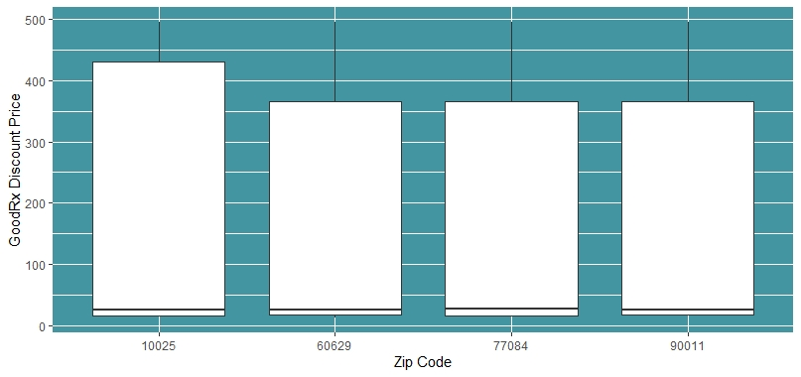
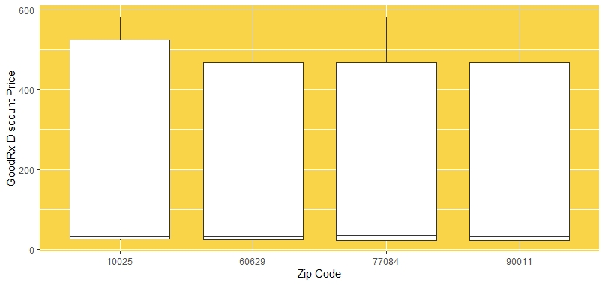
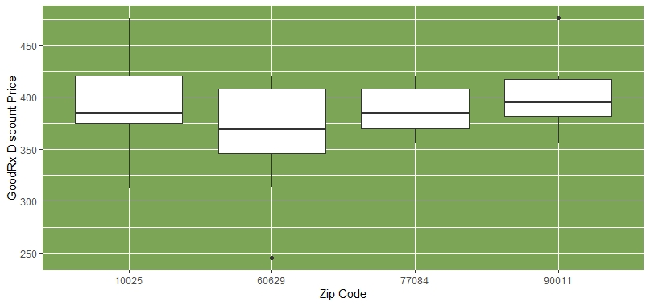
GoodRx Price Variability
Sildenafil | 50mg | 30 count
Tadalafil | 20mg | 30 count
Vardenafil | 20mg | 30 count
Key Observations:
GoodRx brings down the median price significantly.
Median GoodRx price is relatively consistent across zip codes for each medication.
Variability in list price is very high, particularly above the median point for the two most popular medications, Sildenafil and Vardenafil.
Vardenafil shows less variability… perhaps because it’s only recently been available as generic within the past two years.

Slide 8
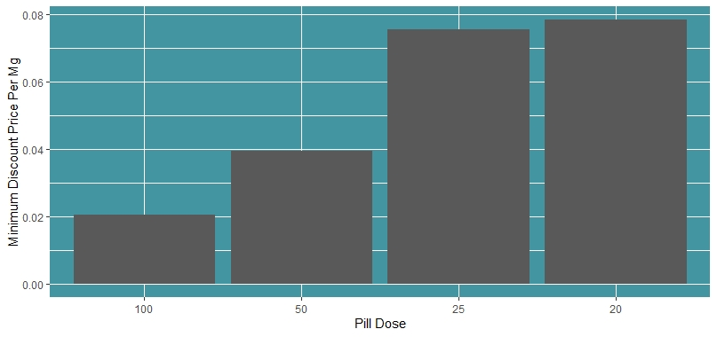
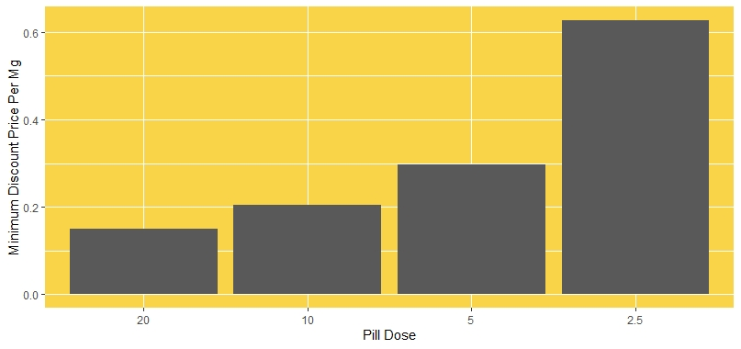
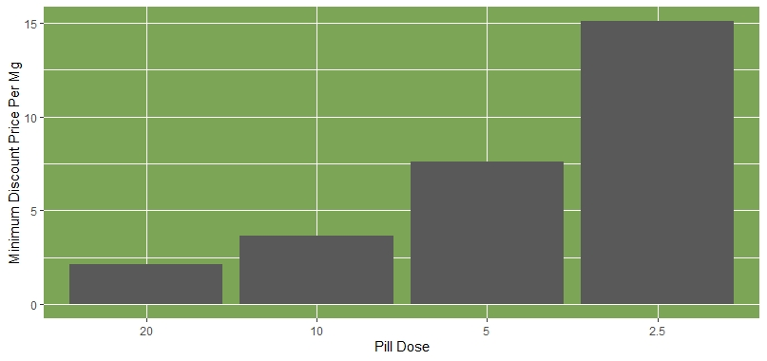
Splitting Pills & Prices
Sildenafil
Tadalafil
Vardenafil
Key Observations:
Important Note: Never split pills without speaking w/your Doctor or Pharmacist first to make sure it is safe. If a pill is safe to split, your Doctor may be willing to write your Rx for a larger dose pill w/instructions to split it. Generally speaking, it is not considered safe to split a pill into sections smaller than one half of the original pill size as it is too difficult to maintain precise dosing.
Savings can be as much as 50% off the minimum GoodRx price when it is safe to split a pill and your Doctor is willing to prescribe your medication in this way.

Slide 9
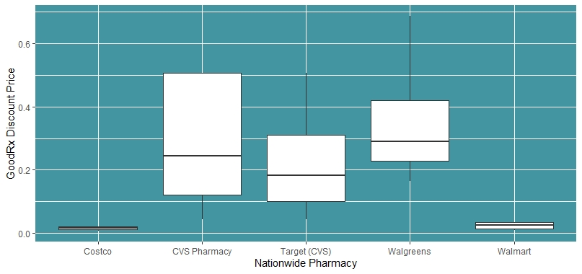
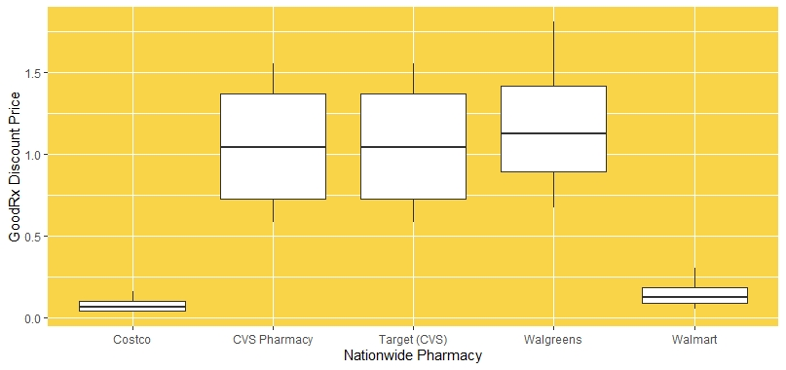
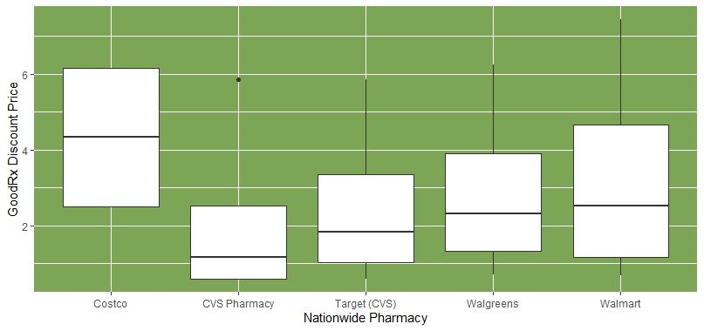
Too Busy to Check the App
Sildenafil
Tadalafil
Vardenafil
Key Observations:
Note: The five pharmacies listed above (out of 28 in the data set) were selected for this analysis as these pharmacies are in the top 25% for appearing most frequently across multiple zipcodes (Nationwide) with a GoodRx discount for the ED medications being studied.
Across multiple zip codes, Costco and Walmart offer the lowest price w/the GoodRx discount on the top two ED medications being studied, Sildenafil and Tadalafil, and with minimal variation.

Slide 10
Opportunities for Further Study
Comparing data across different Rx Discount Programs
Rx Pricing over time
xxx
xxx
Comparing data across different categories of Rxs
Trends in Self-Pay vs Insurance for Rx Medications
xxx
xxx
Comparing data of long-standing generic medications vs newly available as generic
xxx

Slide 11

Thank you
Adriana Bartlett Gray
Email: abartlettg@gmail.com
GitHub: https://github.com/abartlettg/edrx
NYC Data Science Academy
Spring 2021 Cohort

